Slide 1
A Guide to Unix Using Linux Fourth Edition
Introduction to Shell and Script Programming

Slide 2
Objectives
Understand the program development cycle
Compare UNIX/Linux shells for creating scripts
Use shell variables, operators, and wildcard characters
Use shell logic structures
Employ shell scripting to create a menu

Slide 3
Objectives (continued)
Use commands to help debug shell scripts
Explain ways to customize your personal environment
Use the trap command
Develop a menu-based application

Slide 4
Previewing the Application
Shell variables temporarily store values in memory for use by a shell script
Symbolic name: consists of letters, numbers, or characters
References the contents of a variable
Often reflects a variable’s purpose or contents
Shell scripts support many shell script operators
Shell scripts support logic structures
Sequential, decision, looping, and case logic
Also called control structures

Slide 5
Using High-Level Languages
High-level language: computer language that uses English-like expressions
Examples:
ADD 1 TO COUNTER (COBOL)
counter = counter + 1; (C++)
Statements are stored in a source file
Created with an editor such as vi or Emacs
Compiler reads source file and converts it to machine-language instructions
If source file contains syntax errors, it cannot be converted into an executable file

Slide 6
Using UNIX/Linux Shell Scripts
Shell scripts contain sequences of commands
Interpreted instead of compiled
Interpreted by UNIX/Linux shell
If a syntax error is encountered, execution halts
Must be identified as an executable file
Example: $ chmod ugo+x filename <Enter>
Can be run in several ways:
Enter name at prompt (PATH must be set)
Precede name with ./
Provide an absolute path to file
Run less quickly than compiled programs

Slide 7
Prototyping an Application
Prototype: running model of your application
Allows review of final results before committing to design
Shell scripts can be used to create prototypes
Quickest and most efficient method
After prototype is approved, script can be rewritten to run faster using a compiled language (e.g., C++)
If script performs well, no need to convert it to a compiled program

Slide 8
Using Comments
Comment lines begin with a pound (#) symbol
# =======================================================
# Script Name: pact
# By: Your initials
# Date: November 2009
# Purpose: Create temporary file, pnum, to hold the
# count of the number of projects each
# programmer is working on. The pnum file
# consists of:
# prog_num and count fields
# =======================================================
cut -d: -f4 project | sort | uniq -c | awk ’{printf "%s:
%s\n",$2,$1}’ > pnum
# cut prog_num, pipe output to sort to remove duplicates
# and get count for prog/projects.
# output file with prog_number followed by count

Slide 9
Using Comments (continued)
Some examples of what you might comment:
Script name, author(s), creation date, and purpose
Modification date(s) and purpose of each of them
Purpose and types of variables used
Files that are accessed, created, or modified
How logic structures work
Purpose of shell functions
How complex lines of code work
The reasons for including specific commands

Slide 10
The Programming Shell
Three shells that come with most Linux distributions

Slide 11
Variables
Configuration variables
Store information about the setup of OS
Not typically modified after they are set up
Environment variables
Initial values can be changed as needed
Shell variables are created at command line or in a shell script
Useful for temporarily storing information

Slide 12
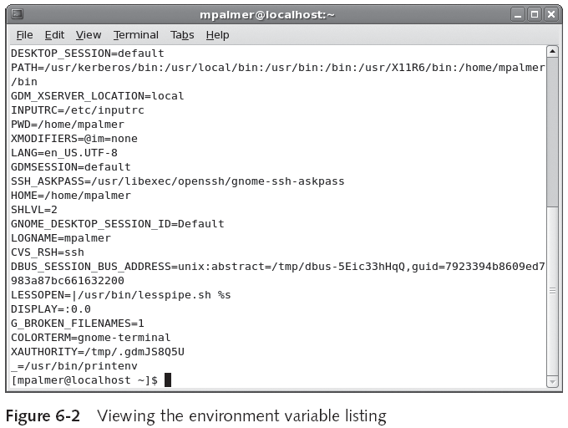
Environment and Configuration Variables

Slide 13
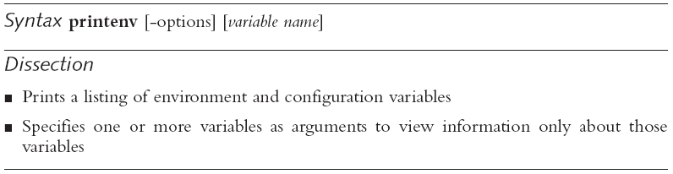
Environment and Configuration Variables (continued)
Use printenv to view list of your current environment and configuration variables
Use set (no arguments) to view current Bash shell environment
Including environment variables, shell script variables, and shell functions

Slide 15
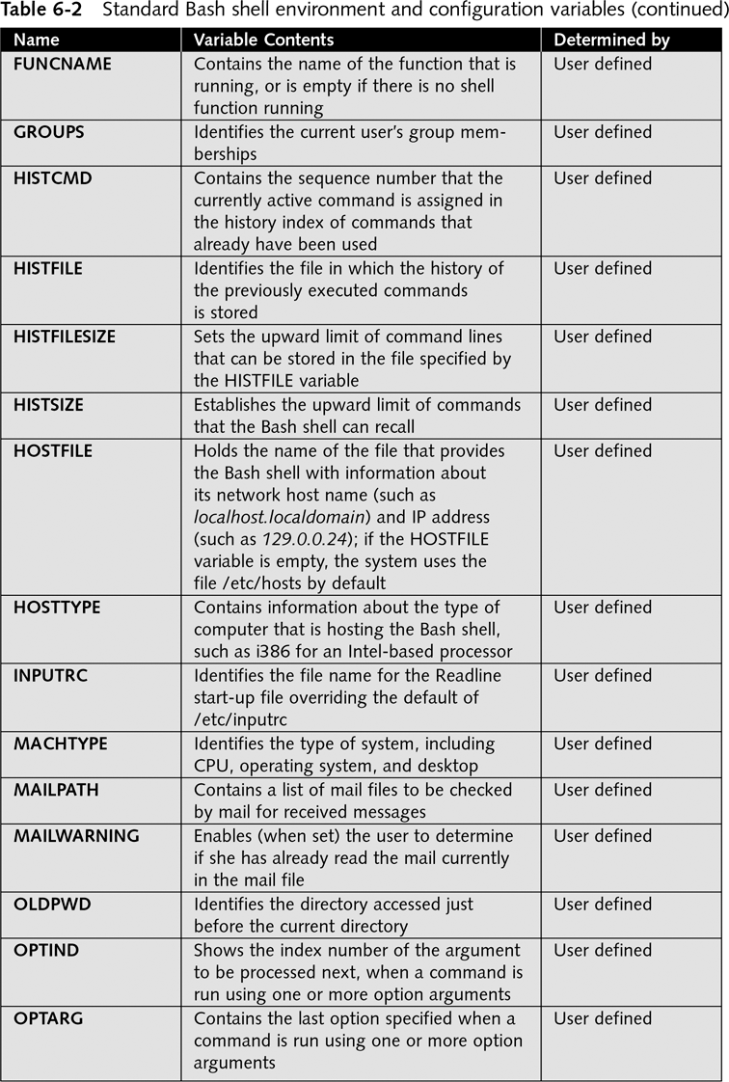

Slide 16
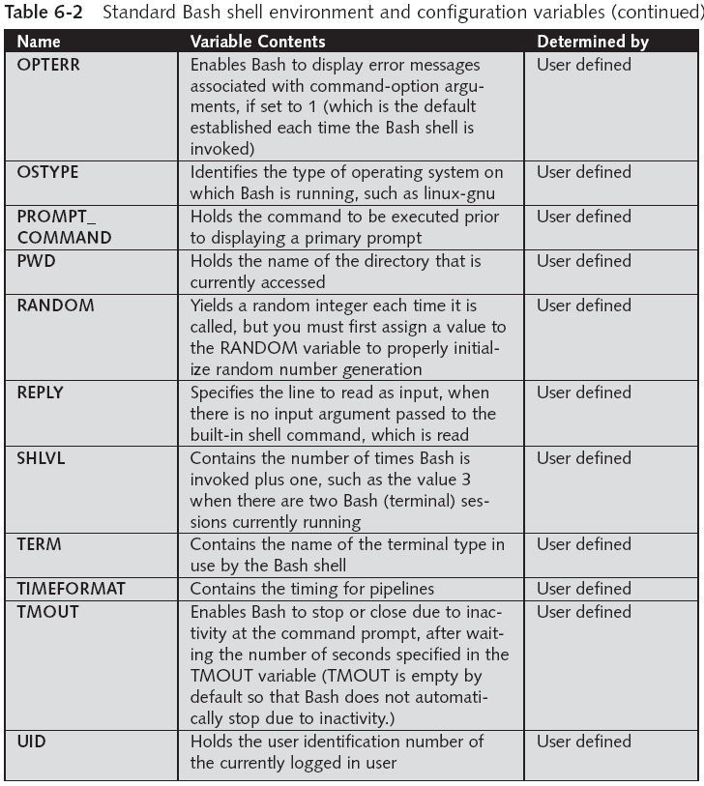

Slide 17
Shell Variables
Basic guidelines for handling shell variables:
Omit spaces when you assign a variable without using single/double quotation marks around value
To assign a variable that must contain spaces, enclose value in “” or ‘’
To reference a variable, use a $ in front of it or enclose it in { }
Use [ ] to refer to a specific value in an array
Export a shell variable to make the variable available to other scripts
To make a shell variable read-only: readonly fname

Slide 18
Shell Variables (continued)
Sample guidelines for naming shell variables:
Avoid using dollar sign in variable names
Use descriptive names
Use capitalization appropriately and consistently
If a variable name is to consist of two or more words, use underscores between the words

Slide 19
Shell Operators
Bash shell operators are divided into four groups:
Defining operators
Evaluating operators
Arithmetic and relational operators
Redirection operators

Slide 20
Defining Operators
Defining operators: assigns a value to a variable
Examples:
NAME=Becky
NAME="Becky J. Zubrow"
LIST= `ls`

Slide 21
Evaluating Operators
Display contents of a variable via an evaluating operator
Examples:
echo $NAME
echo "$NAME"
echo '$NAME'

Slide 22
Arithmetic and Relational Operators
The usual mathematical precedence rules apply:
Multiplication and division are performed before addition and subtraction

Slide 23
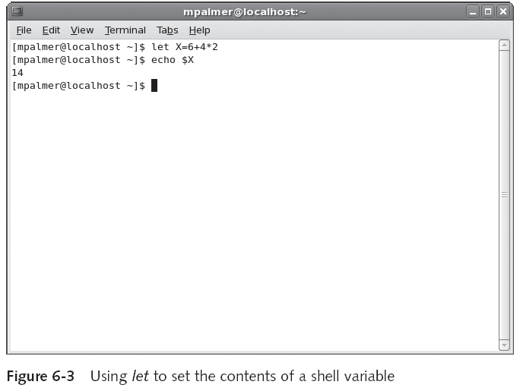
Arithmetic and Relational Operators (continued)

Slide 24
Arithmetic and Relational Operators (continued)
Shell variables can be used as operands
Assuming X has the value 14, the following command stores 18 in Y:
let Y=X+4
Y=$((X+4))
let is a built-in command for the Bash shell

Slide 25
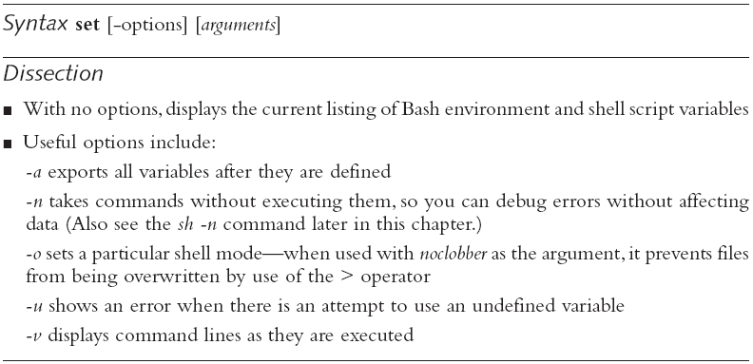
Redirection Operators
Examples:
$ set -o noclobber <Enter>
$ cat new_file > old_file <Enter>
bash: old_file: cannot overwrite existing file
$ cat new_file >| old_file <Enter>

Slide 26
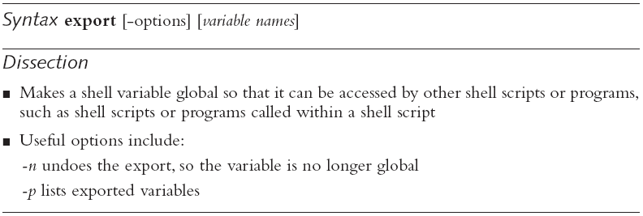
Exporting Shell Variables to the Environment
Scripts cannot automatically access variables created/assigned on command line or by other scripts
You must use export first

Slide 27
Modifying the PATH Variable
The shell looks for programs in the PATH
./filename runs script
./ needed if current directory is not in PATH
To see the directories in your path:
echo $PATH
Sample output: /usr/local/bin:/usr/bin:/bin:/usr/X11R6/bin
To add the current working directory to the PATH:
PATH=$PATH:.

Slide 28
More About Wildcard Characters
Wildcard characters are known as glob characters
Shell processes glob characters in unquoted arguments for file name generation
Glob characters are part of glob patterns
Intended to match file names and words
Special constructions that appear in glob patterns:
?
*
[chars]
Example: more chap[1-3] <Enter>

Slide 29
Shell Logic Structures
The four basic logic structures needed for program development:
Sequential logic
Decision logic
Looping logic
Case logic

Slide 30
Sequential Logic
Sequential logic: commands are executed in the order in which they appear in the script or program
Only break in sequence logic comes when a branch instruction changes the flow of execution
Example: Programming Activity Status Report (shown on next slide)

Slide 31
Sequential Logic (continued)
#================================================================
# Script Name: practivity
# By: MP
# Date: November 2009
# Purpose: Generate Programmer Activity Status Report
#================================================================
cut -d: -f4 project | sort | uniq -c | awk ’{printf "%s:
%s \n",$2,$1}’ > pnum
cut -d: -f1-4 programmer | sort -t: +0 -1 | uniq > pnn
join -t: -a1 -j1 1 -j2 1 pnn pnum > pactrep
# Print the report
awk ’
BEGIN {
{ FS = ":" }
{ print "\tProgrammer Activity Status Report\n" }
{ "date" | getline d }
{ printf "\t %s\n",d }
{ print "Prog# \t*--Name--* Projects\n" }
{ print "==============================================\n"}
}
{ printf "%-s\t%-12.12s %-12.12s %s\t%d\n",
$1, $2, $3, $4, $5 } ’ pactrep
# remove all the temporary files
rm pnum pnn pactrep

Slide 32
Decision Logic
Decision logic enables your script to execute a statement (or series of) if a certain condition exists
if statement: primary decision-making logic structure
Example:
echo -n "What is your favorite vegetable? "
read veg_name
if [ "$veg_name" = "broccoli" ]
then
echo "Broccoli is a healthy choice."
else
if [ "$veg_name" = "carrots" ]
then
echo "Carrots are great for you."
else
echo "Don't forget to eat your broccoli also."
fi
fi

Slide 33
Looping Logic
In looping logic, a control structure repeats until a specific condition exists or some action occurs
Examples:
for loop
while loop

Slide 34
The For Loop
Use for to loop through a range of values
In the example, the loop repeats six times
for USERS in john ellen tom becky eli jill
do
echo $USERS
done

Slide 35
Executing Control Structures at the Command Line

Slide 36
Using Wildcard Characters in a Loop
The [ ] wildcard characters can be useful in loops
Example:
for file in chap[1234]; do
more $file
done

Slide 37
The While Loop
while continues to loop and execute statements as long as condition is true
Example:
echo -n "Try to guess my favorite color: "
read guess
while [ "$guess" != "red" ]; do
echo "No, not that one. Try again. "; read guess
done

Slide 38
Case Logic
Case logic structure simplifies selection of a match when you have a list of choices
Useful for user menus
Example:
echo -n "Enter your favorite color: "; read color
case "$color" in
"blue") echo "As in My Blue Heaven.";;
"yellow") echo "As in the Yellow Sunset.";;
"red") echo "As in Red Rover, Red Rover.";;
"orange") echo "As in Autumn has shades of Orange.";;
*) echo "Sorry, I do not know that color.";;
esac

Slide 39
Using Shell Scripting to Create a Menu
Examples:
tput cup 0 0
tput clear
tput cols

Slide 40
Debugging a Shell Script
sh includes several options for debugging

Slide 41
Customizing Your Personal Environment
Login script: runs after you log in to your account
.bashrc file can be used to establish customizations that take effect for each login session
Alias: name that represents another command
alias rm="rm -i"

Slide 42
Customizing Your Personal Environment (continued)
Example:
# .bashrc
# Source global definitions
if [ -f /etc/bashrc ]; then
. /etc/bashrc # if any global definitions are defined
# run them first
alias rm=’rm -i’ # make sure user is prompted before
# removing files
alias mv=’mv -i’ # make sure user is prompted before
# overlaying files
set -o ignoreeof # Do not allow Ctrl-d to log out
set -o noclobber # Force user to enter >| to write
# over existing files
PS1="\w \$" # Set prompt to show working directory

Slide 43
The trap Command
Example: trap "rm ~/tmp/* 2> /dev/null; exit" 0

Slide 44
Putting it All Together in an Application
Create a multifunctional application:
Assign and manage variables
Use shell operators
Employ shell logic structures
Use additional wildcard characters
Use tput for screen initialization and text placement
Use trap to clean up temporary files
In Hands-On Projects 6-15 through 6-20, you build a multipurpose application

Slide 45
Summary
A shell interprets UNIX/Linux shell scripts
Scripts are not interpreted, not compiled
Shell scripts can be created with any text editor
Linux shells are derived from the UNIX Bourne, Korn, and C shells
UNIX/Linux employ three types of variables:
Configuration, environment, and shell
The shell supports many operators
Use wildcard characters in shell scripts

Slide 46
Summary (continued)
Logic structures supported by the shell:
Sequential, decision, looping, and case
Use tput to manage cursor placement
Customize your .bashrc file
Create aliases to simplify commonly used commands
Use trap inside a script file to remove temporary files after the script file has been run (exited)

Slide 47
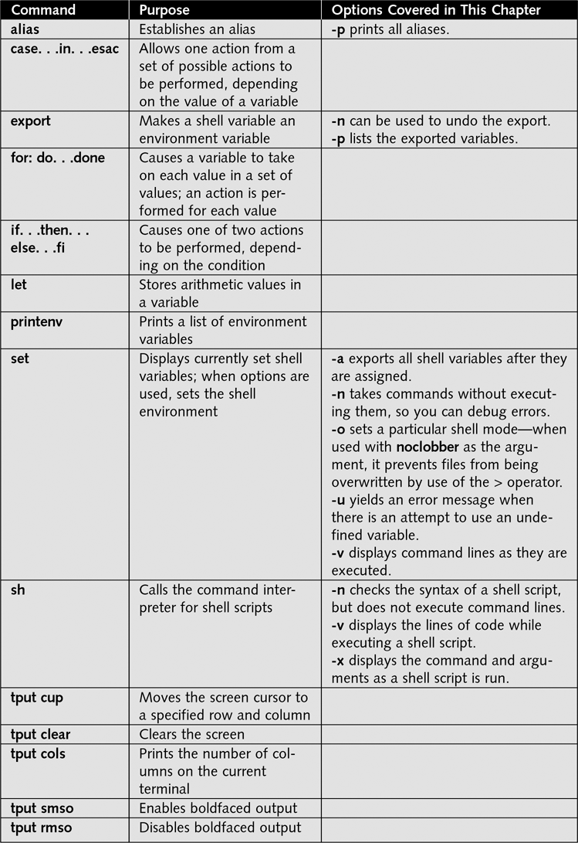
Command Summary

Slide 48
